Slide 1
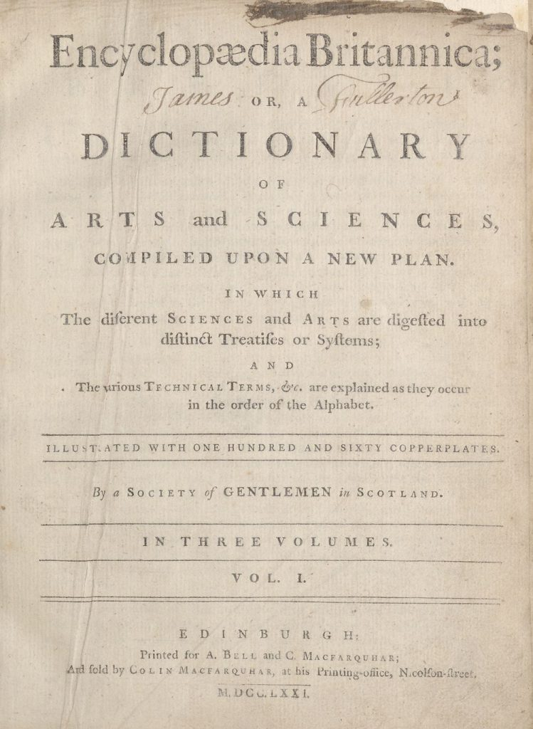
frances: An AI-toolbox to discover automatically insights from Data Foundry collections
Dr. Rosa Filgueira,
Assistant Professor,
Heriot-Watt University,
Email: R.Filgueira@hw.ac.uk

Slide 2
frances*: New AI-toolbox to discover automatically insights
New ways to unlock the full value of NLS digital collections
Objective 1 : New facilities to run more complex text analysis queries → ML/NLP techniques.
Objective 2: Full integration with NLS Data Foundry → Hide the large-scale text mining complexity
Using the Encyclopaedia Britannica as the core dataset
(*) Frances Wright (September 6, 1795 – December 13, 1852)
4/11

Slide 3
The Journey
From Semi-Structured EB information (ALTO & METS XML files) → Information Extraction → Knowledge Graph → Deep Transfer learning → To Augmented EB-Knowledge Graph with advance AI-method
Querying Augment EB Knowledge Graph:
Extracting information already stored in the EB-Knowledge Graph
Processing information stored in the EB-Knowledge Graph in parallel → Create new data/results

Slide 4
Phase 1: Text Mining
METS & ALTO-XML

Slide 5
Phase 1: Text Mining
1.1. Improved defoe Extract Terms query → It extracts the Eb Terms by page and classify them between articles and topics
Extracted Terms Based on Heuristics --`> Pages Layout & Text & Headers → Different heuristics for different EB editions. Using ALTO-XML information.
(Terms v.1)

Slide 6
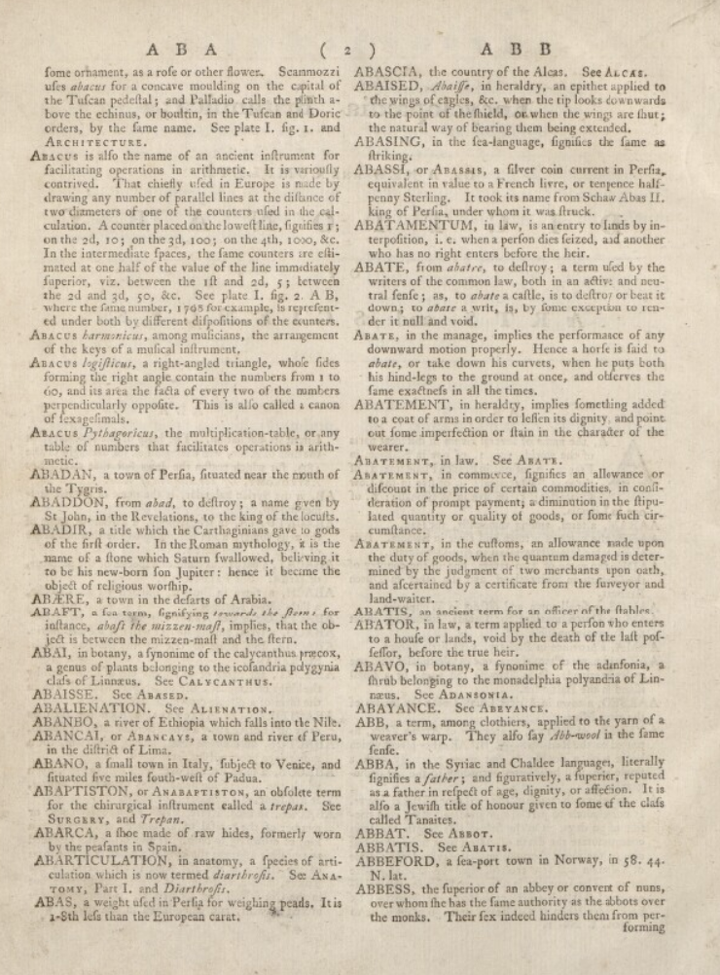
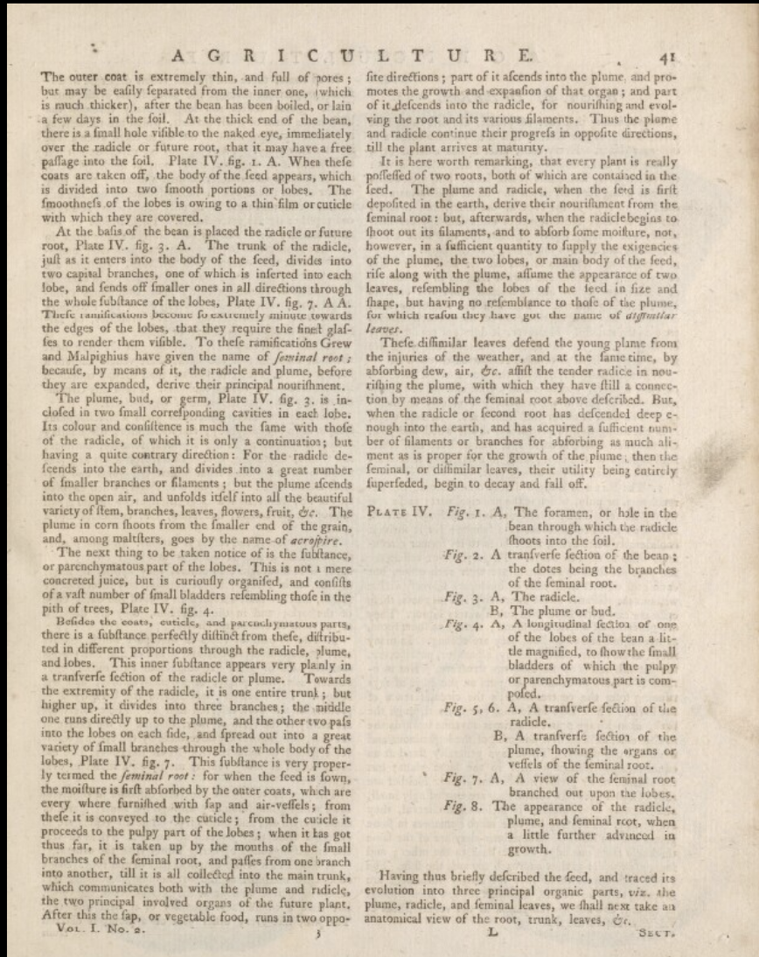
1. Detecting pages headers from ALTO XML
2. Using headers to classify terms into: Articles & Topics
3. Using ALTO Text for detecting the start of each article:
--> Starting a line with TERM UPPERCASE + “,” .
Phase 1: Text Mining
Articles
Topic
Edition 1 - 1771

Slide 7
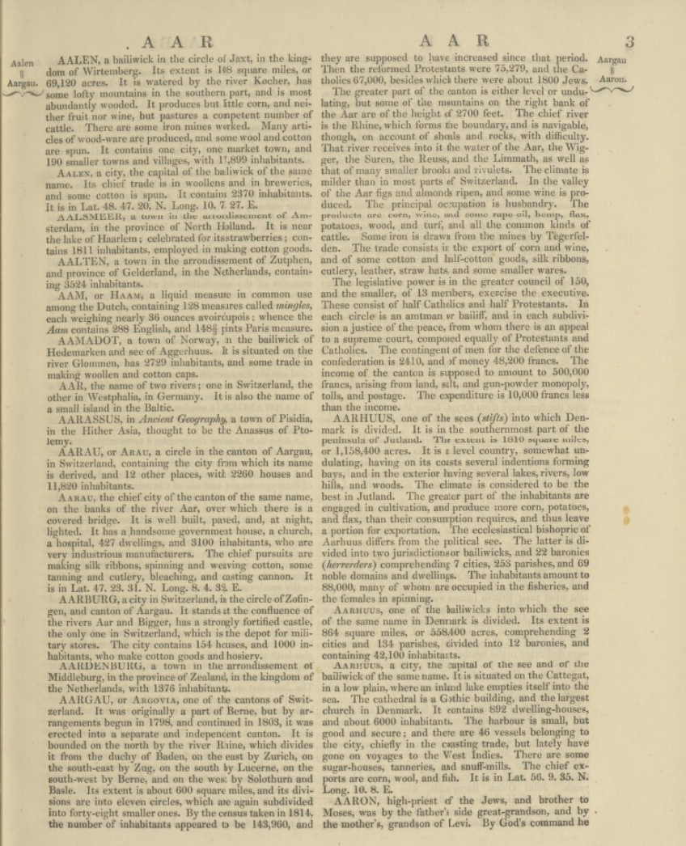
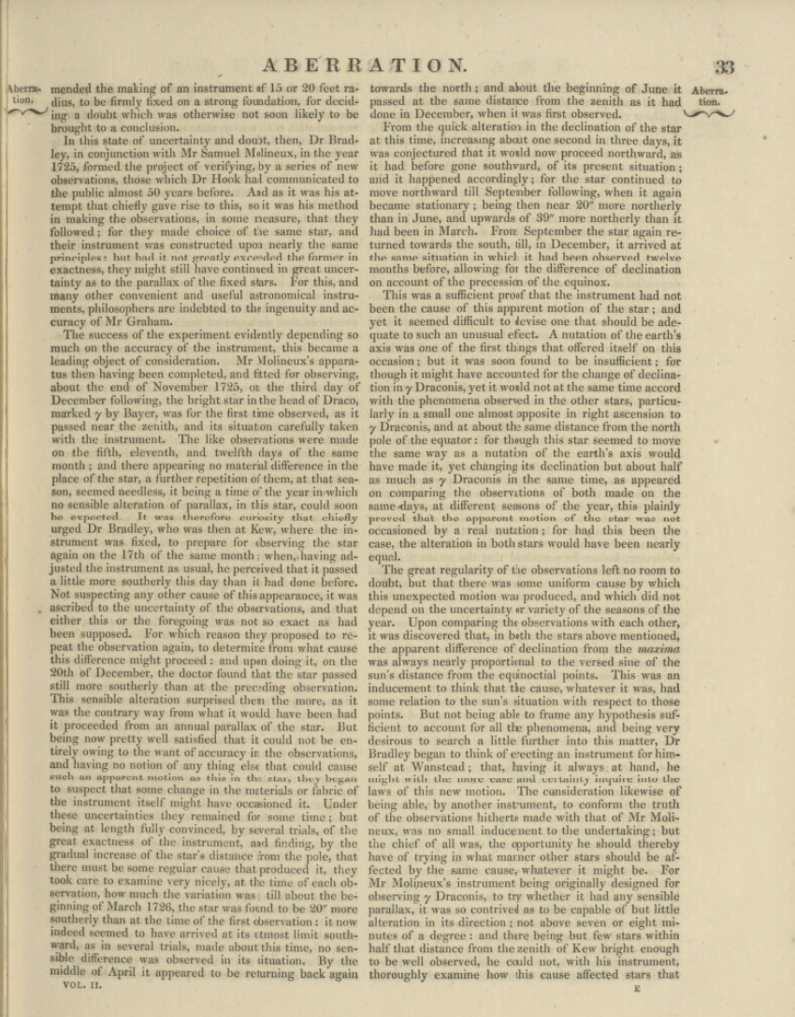
1. Detecting pages headers from ALTO XML
2. Using headers to classify terms into: Articles & Topics
3. Using ALTO Text for detecting the start of each article:
--> Starting a line with TERM UPPERCASE + “,” .
Phase 1: Text Mining
Articles
Topic
Edition 7

Slide 8
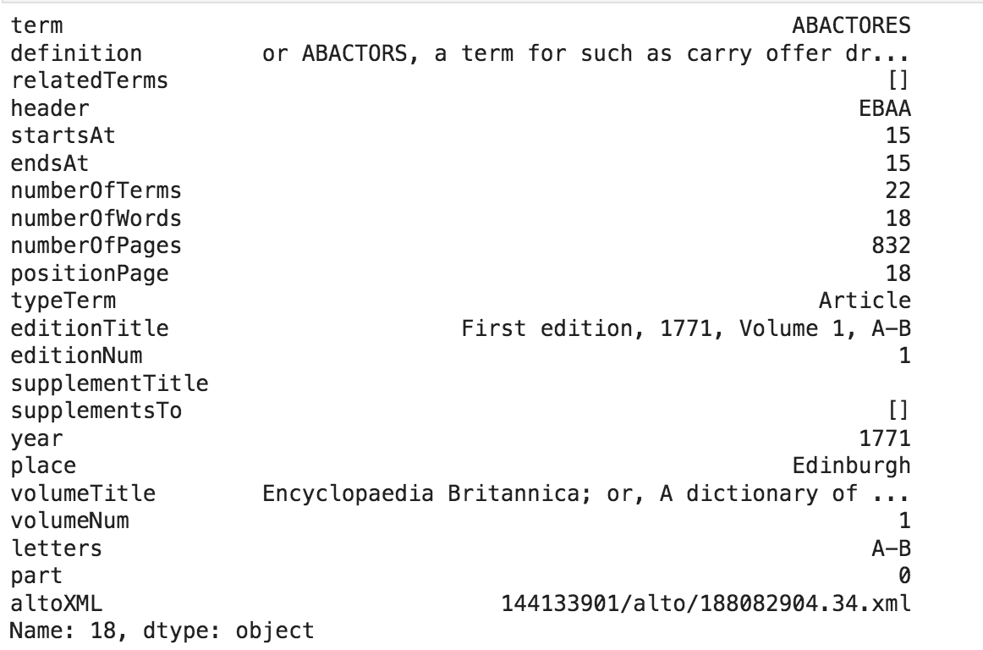
Extract EB Terms
Extracted Term ABACATORES information - Edition 1, 1771, Vol A-B

Slide 9
Phase 1: Text Mining
1.2 Improved defoe Metadata Extraction query → It extracts the metadata per Edition and Volume (Metadata v.1)
Based on METS information

Slide 10
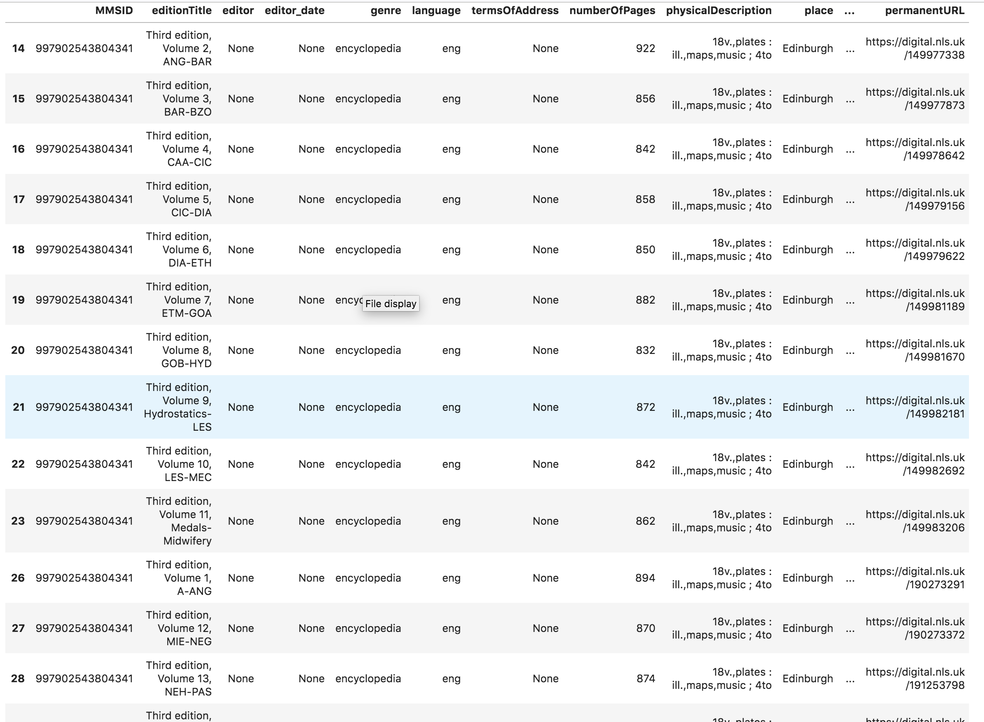
Extract collection Metadata (METS)
Metadata of some of the Volumes of Edition 3

Slide 11
Phase 1: Text Mining
1.3. New Post-processing python scripts (*) to improve the previous results:
- Re-classification of Terms v.1 (articles and topics)
- Join terms spitted across pages
We get here: Terms & Metadata v.2
(*) Also Based on Heuristics --`> Pages Layout & Text & Headers → different heuristics for different EB editions.

Slide 12
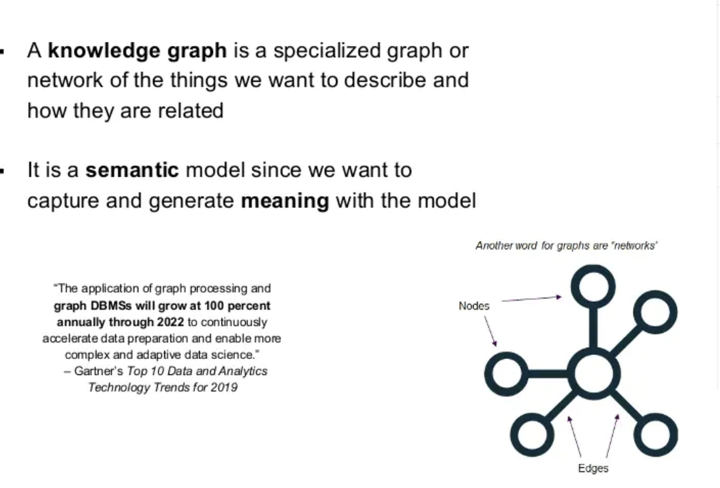
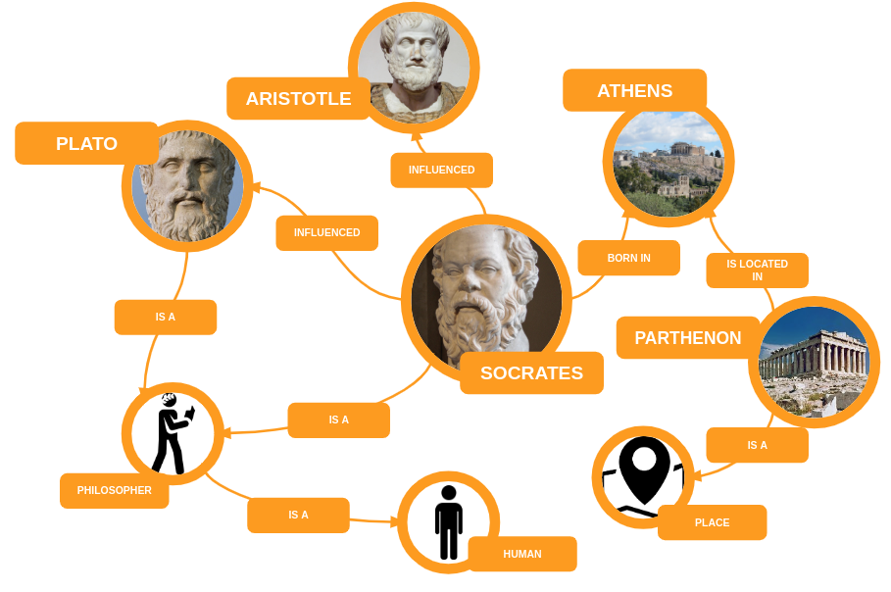
Phase 2: Knowledge Graph
Knowledge Graph: Incorporate human knowledge into intelligent systems, exploiting a semantic graph perspective

Slide 13
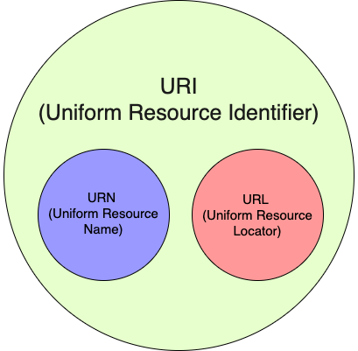
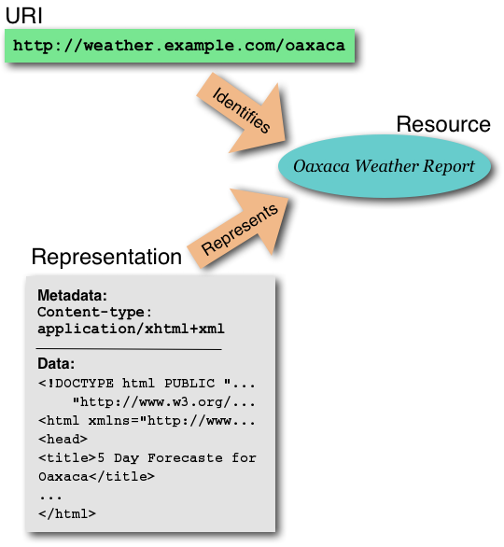
Phase 2: Knowledge Graph
Knowledge Graph: Incorporate human knowledge into intelligent systems, exploiting a semantic graph perspective
URI: A Universal Resource Identifier, is defined to be an ASCII string used to identify “things” on the Knowledge Graph

Slide 14
Phase 2: Knowledge Graph
Knowledge Graph: Incorporate human knowledge into intelligent systems, exploiting a semantic graph perspective
2.1. Create EB Ontology: To explain (give meaning) how our “thing” are related with each other.
In order to create and publish the EB-Ontology I used:
diagrams.net : To create an UML with the EB information (classes, properties, relationships, etc.)
Chowlk : To convert the UML into an OWL ontology
Widoco: To publish and create an enriched and customized documentation of the ontology
w3id.org: To configure my permanent Identifier for EB ontology → https://w3id.org/eb/
EB-Ontology : https://github.com/francesNLP/EB-ontology

Slide 15
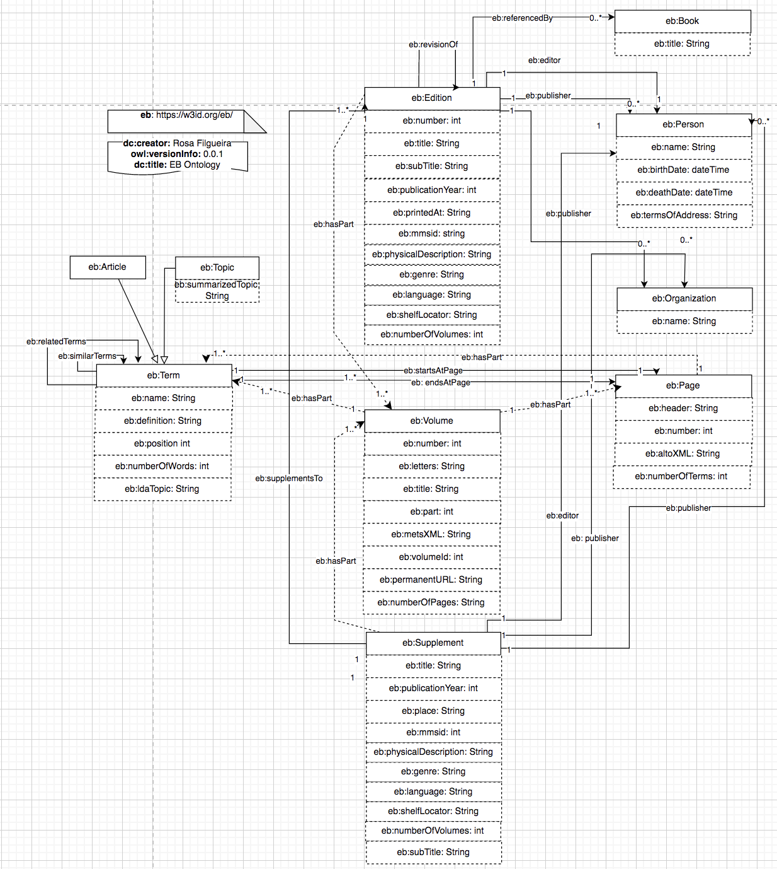
https://w3id.org/eb

Slide 16
Phase 2: Knowledge Graph
Knowledge Graph: Incorporate human knowledge into intelligent systems, exploiting a semantic graph perspective
2.1. Created EB Ontology: The description of this ontology is available online at http: https://w3id.org/eb/
2.2 . Created EB Knowledge Graph 1.0: Populated the post-processed information (extracted Terms & Metadata v.2) into a RDF triplestore using the EB Ontology
- My RDF EB-data is stored in an Apache Jena FUSEKI SPARQL server – Used this Fuseki-docker image to set up my SPARQL server/end-point
NOTE:
Each Term, Edition, Page, Volume, etc … is a Resource in our Knowledge Graph
and has an URI to identify it.

Slide 17
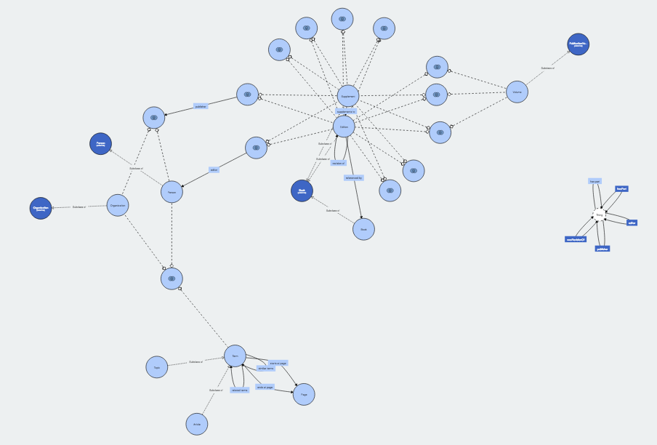
EB Knowledge Graph

Slide 18
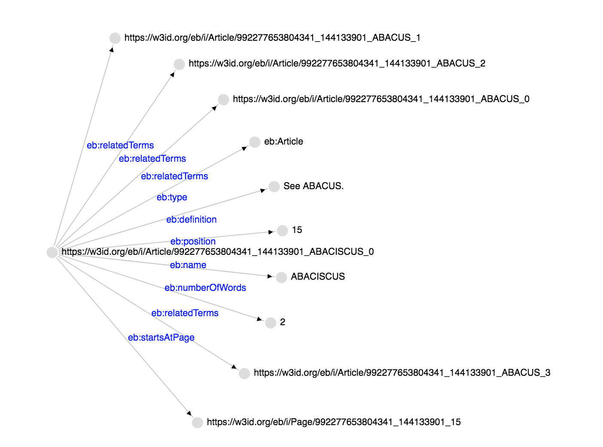
EB Knowledge Graph
Term ABACISCUS, URI: https://w3id.org/eb/i/Article/992277653804341_144133901_ABACISCUS_0

Slide 19
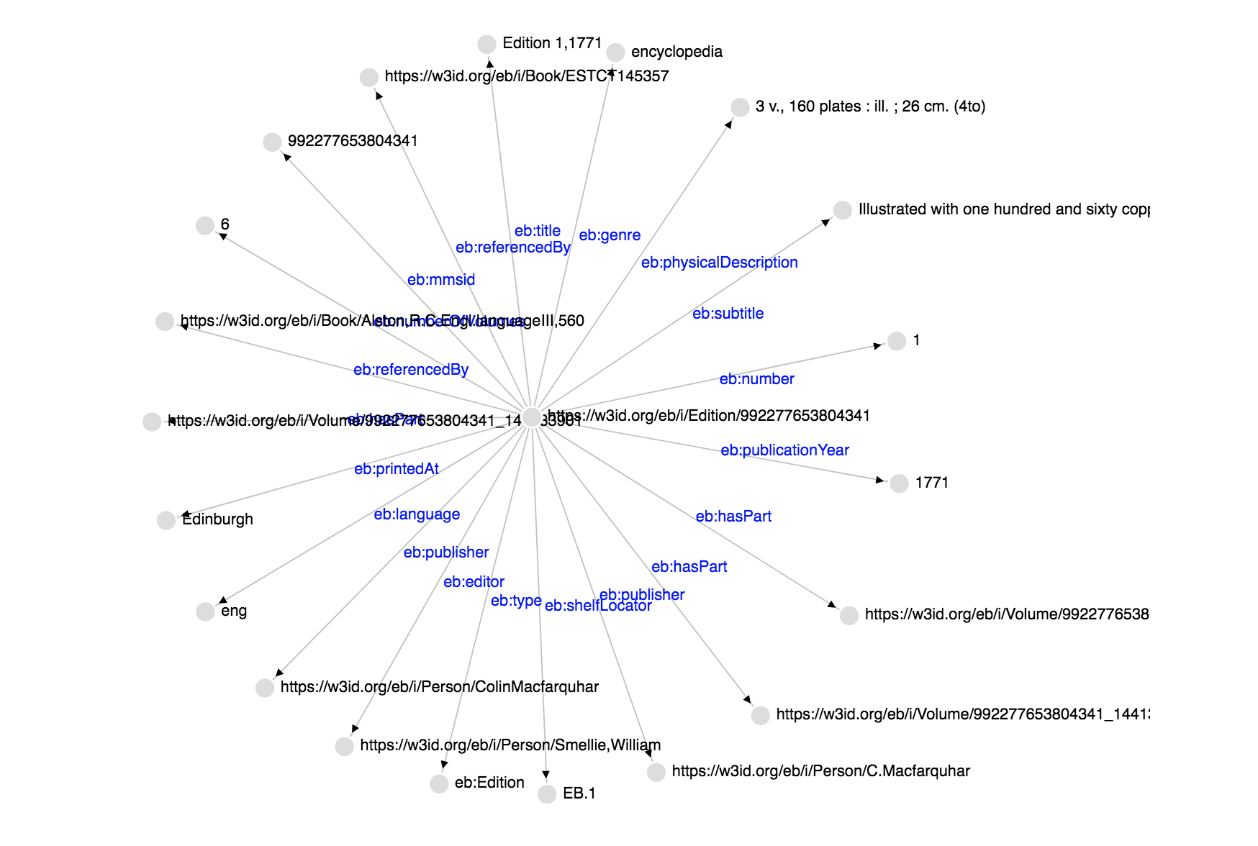
EB Knowledge Graph
Edition 1, 1771 – URI: https://w3id.org/eb/i/Edition/992277653804341

Slide 20
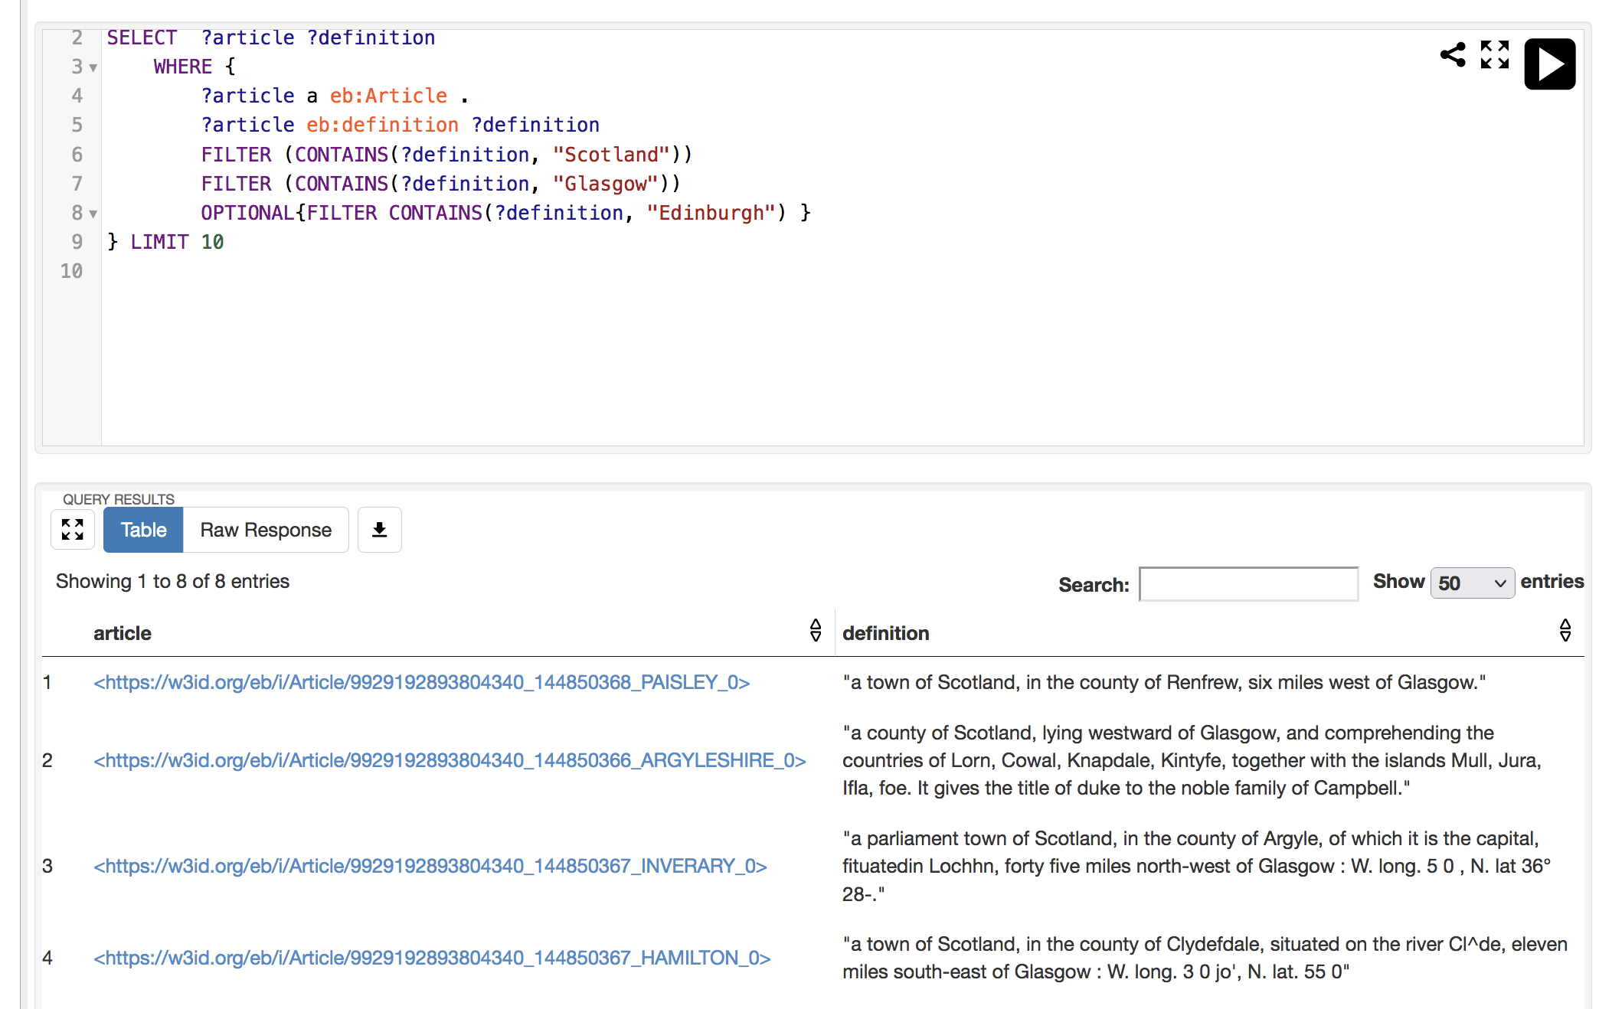
EB Knowledge Graph – Querying our KG
SPARQL is an RDF query language—that is, a semantic query language for databases—able to retrieve
and manipulate data stored in Resource Description Framework (RDF) format.
Fuseki RDF triplestore

Slide 21
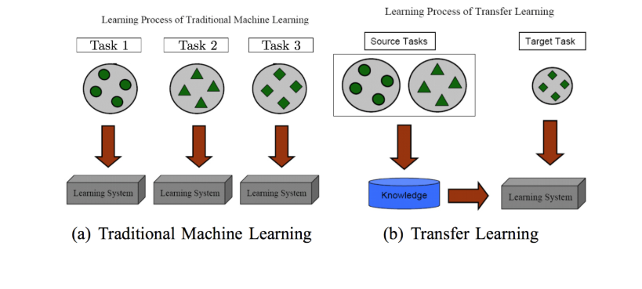
Phase 3: Augmented Knowledge Graph with Deep Transfer Learning

Slide 22
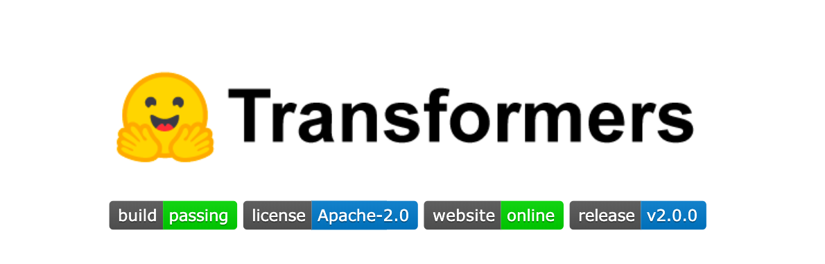
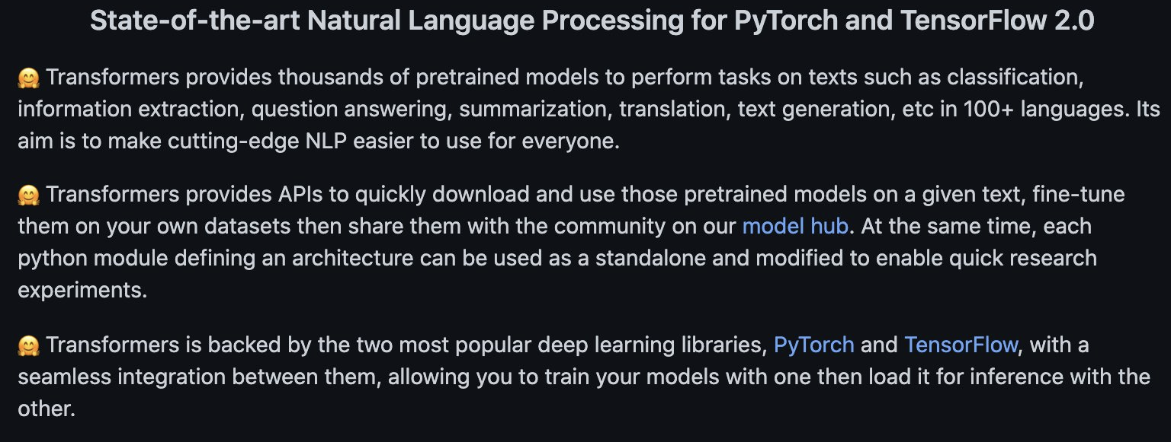
Phase 3: Augmented Knowledge Graph with Deep Transfer Learning

Slide 23
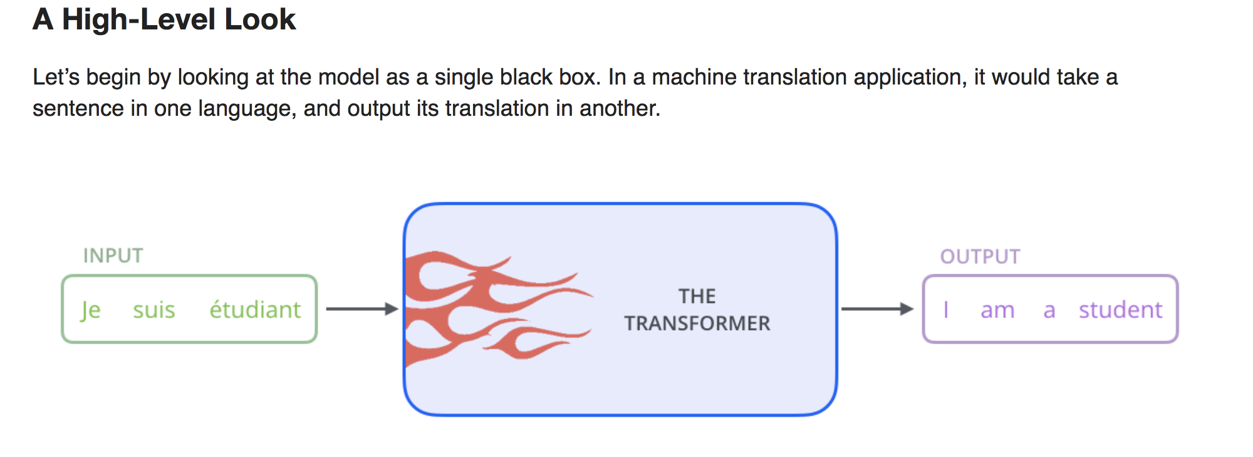
Phase 3: Augmented Knowledge Graph with Deep Transfer Learning

Slide 24
Phase 3: Augmented Knowledge Graph with Deep Transferring Learning
EB Knowledge Graph 2.0: previous info + storing the result of applying different deep learning transformers analyses:
- sentiment analyses: Classifying text between positive and negative - transformer: siebert/sentiment-roberta-large-english
- topic modelling: Clustering terms into topics
– transformer: all-mpnet-base-v2
- term similarity: Comparing text & semantic similarity
- transformer: all-mpnet-base-v2
- spelling checking: Finding misspelling/ocr errors and fixing them
- transformer: neuspell + ElmosclstmChecker
- term evolution: Checking how a term has changed over the years
– transformer: all-mpnet-base-v2
- summarization: Summarizing the text of a topic term (XLNET)
– transformer: XLNeT

Slide 25
Phase 3: Augmented Knowledge Graph with Deep Transferring Learning
EB Knowledge Graph 2.0: previous info + storing the result of applying different deep learning transformers analyses:
- sentiment analyses: Classifying text between positive and negative
- topic modelling: Clustering terms into topics
- term similarity: Comparing text & semantic similarity
- spelling checking: Finding misspelling/ocr errors and fixing them
- term evolution: Checking how a term has changed over the years
- summarization: Summarizing the text of a topic term
Example: Spelling Checking → Lewis Term
Cleaned Definition
Compute Difference

Slide 26
Phase 3: Augmented Knowledge Graph with Deep Transferring Learning
Two types of “queries” against the EB Knowledge Graph 2.0 :
Type 1: Extracting information from the EB Knowledge → SPARQL → We “just” navigate through the KG to get the desired information.
Example: Given a Term ( e.g., Edinburgh), I can get the Edition Information (e.g., Edition Title)
Type 2: Processing information from the EB Knowledge → defoe → We are going to process further the definitions from the selected terms.
But for doing this we needed to do some work on defoe first → Phase 4
Term
Volume
Edition

Slide 27
Phase 4: Defoe and Knowledge Graph
4.1. Created a new KG defoe connector (based in SPARQL) to run defoe queries using the EB Knowledge Graph as a source of data → defoe_KG
4.2. Improved defoe queries to be fully configurable: different filtering options, target, lexicon, etc.
EB Knowledge Graph 2.0
defoe_KG
Configurations

Slide 28
Phase 4: Defoe and Knowledge Graph
4.3 defoe text mining queries:
frequency_keysearch: Count number of terms or times in which appear keywords or keysentences and group by years. Several filtering options.
term_fulltext_keysearch: Extract terms definitions in which appear keywords or keysentences and group by years. Several filtering options.
term_snippet_keysearch: Extract snippet of definition in which appear keywords or keysentences and group by years. Several filtering options, including the snippet size.
publication_normalization: Extract number of documents, pages, words per year.
uris_keysearch: Extract uris of terms in which appear keywords or keysentences and group by years. Several filtering options.
geoparser_terms: Geoparsing the term definition in which appear keywords or keysentences and group by years. Several filtering options.
EB Knowledge Graph 2.0
defoe_KG
Configurations

Slide 29
Phase 4: Defoe and Knowledge Graph
4.4 Created new defoe ML/NLP queries (using also deep learning transformers)
- sentiment analysis: calculate the sentiment analyses of selected terms.
- topic modelling: calculate the topic of selected terms. Filtering options.
- spelling checker: check the spelling of selected terms. Filtering options.
(TO-DO)
EB Knowledge Graph 2.0
defoe_KG
Configurations

Slide 30
Phase 5: Flask Web-Application
5.1 Web-User Interface:
So, users DO NOT have to create SPARQL or defoe queries – the web-application does it from them ➔ Abstraction to SPARQL & DEFOE
The web-app run both types of queries and visualize the results
Functionalities:
- Term Search
- Term Similarity
- Topic Modelling
- Spelling Checker
- Defoe queries
- EB Details
- Knowledge Graph Resources Visualizations
5.2 Flask + JQuery + JavaScript + HTML + CSS + Web-services + Plotly

Slide 31
Summary
EB ALTO & METS + defoe → Extracted Terms & Metadata (v.1)
Extracted terms and metadata (v.1) + postprocessing scripts:
Final set of Terms & Metadata (v.2)
EB ontology
Terms & Metadata (v.2) + EB ontology → EB Knowledge Graph 1.0
EB Knowledge Graph 1.0 + Transformers → EB Knowledge Graph 2.0
EB Knowledge Graph 2.0 + defoe → defoe_KG
defoe_KG + configurable defoe queries
EB Knowledge Graph 2.0 + defoe_KG + defoe queries (text mining/ NLP)
EB Knowledge Graph Queries:
Type 1: SPARQL queries: Extracting the EB KG data
Type 2: defoe queries: Processing the EB KG data
Flask-web app: Abstractions to SPARQL and defoe queries

Slide 32
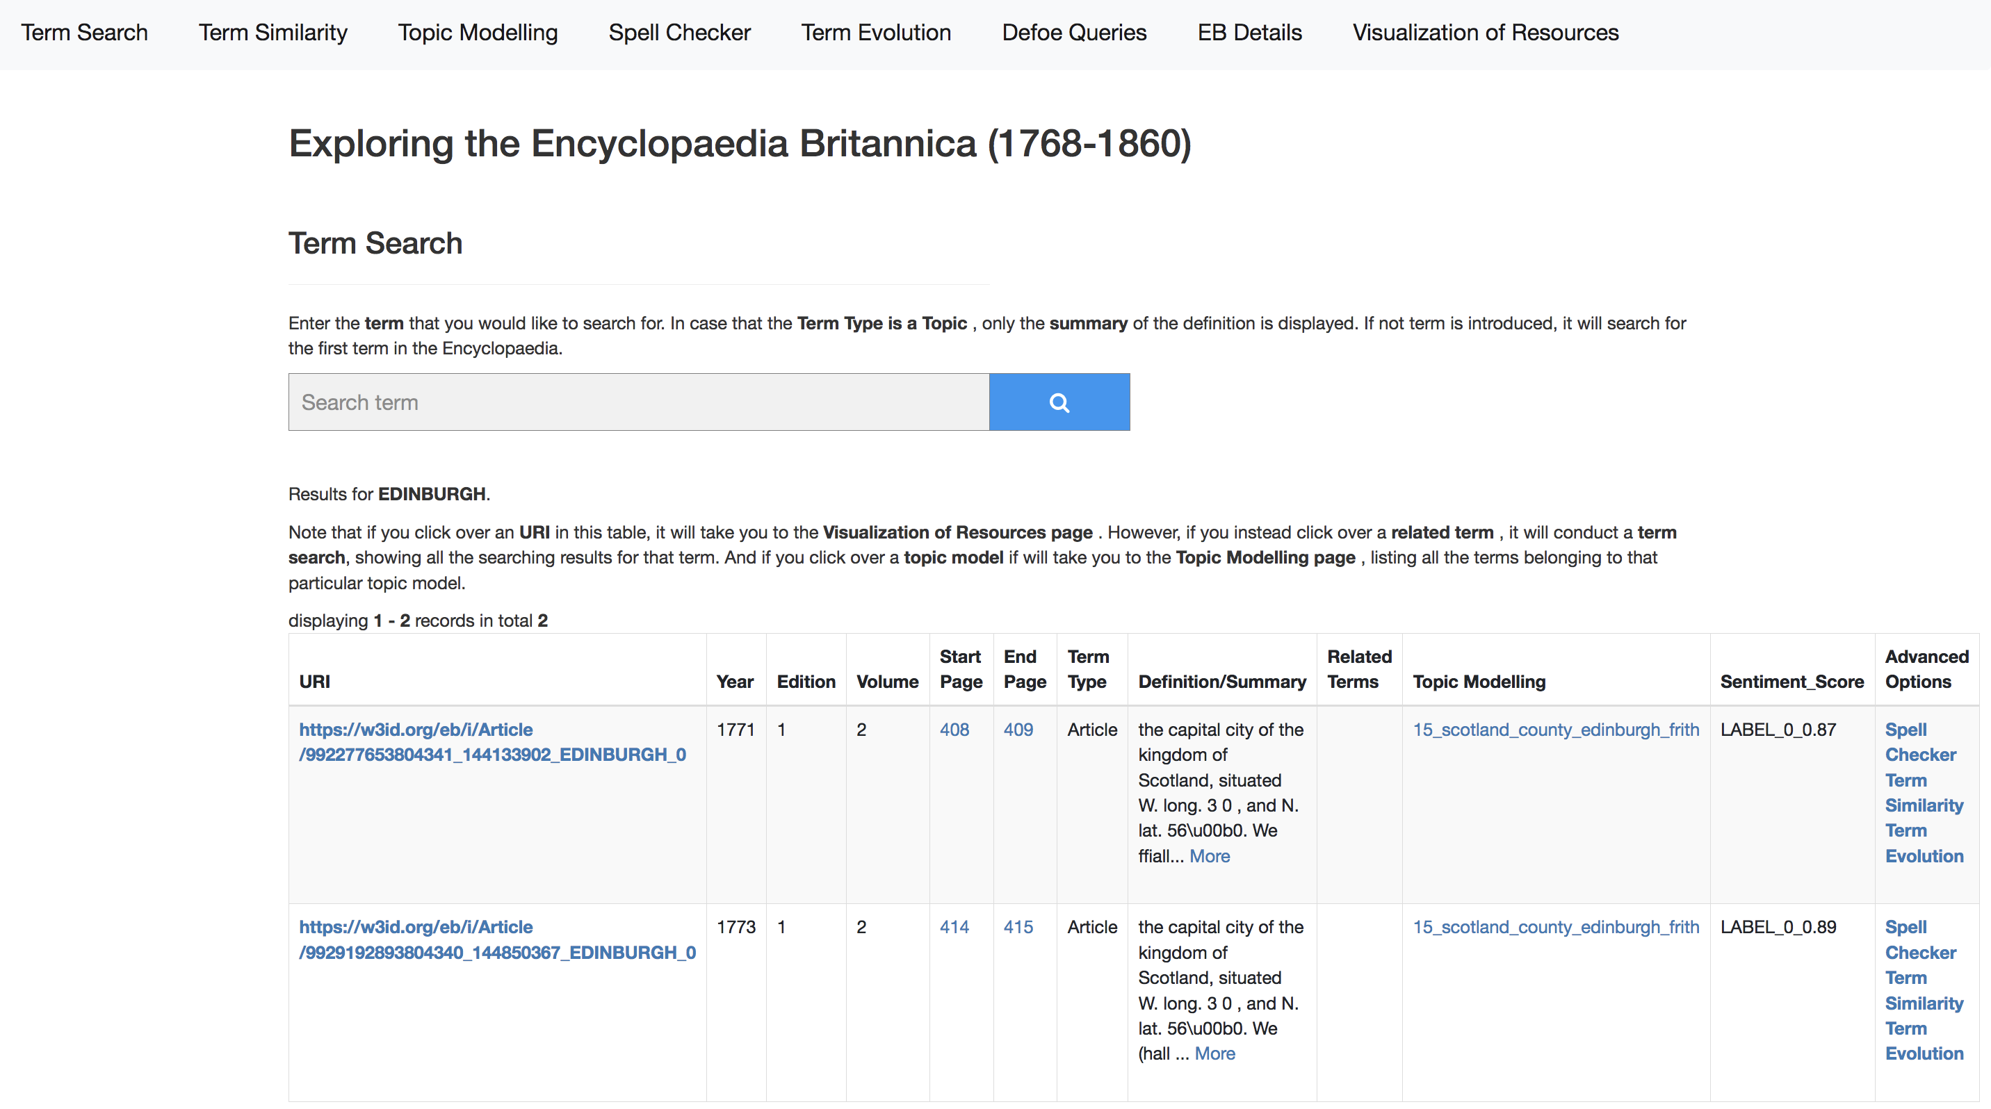
Interacting with the EB Knowledge Graph
FLASK Web-Application

Slide 33
Interacting with the EB Knowledge Graph
Type 1
Type 2
Type 1
Note: Two types of EB-KG queries
- Type 1: Extracting information from EB-KG – Navigating across the KG
- Type 2: Processing information from EB-KG -- Processing in parallel further the Term’s definitions (stored in KG).

Slide 34
frances: Architecture
NSL Data Foundry Collections
defoe
frances - User interface
Scanned
text
Parallel Data ingestion:
- NLP preprocessing pipeline
- Postprocessing data-
- Transform data to RDF
(Knowledge Graph)
- defoe Text-mining queries
- ML/NLP analyses
- Transformers, Bert, RoBerTa,
.
Knowledge
Graph
defoe
+sparql
Scanned
text
Results
Scanned
text
Visualizations
- N-grams,
- Knowledge graph
Download Results
Exploring further results

